Slide 1

EMAS, a premium environmental management tool for organisations
Benefits for public authorities

Slide 2
Content
1
What is EMAS?
How can Member States benefit from EMAS?
What is the added value of EMAS over other instruments?
How is EMAS related to other policies?
What can be done by public authorities?
Which instruments are available?
Focus on regulatory relief
Summary
2
3
4
5
6
7
8

Slide 3
What is EMAS?
The EU Eco-Management and Audit Scheme (EMAS) is a voluntary premium management instrument developed by the European Commission for companies and other organisations to evaluate, report, and improve their environmental performance.
Companies and other organisations that decide to implement the management system: set up procedures to assess and improve their environmental performance. If they fulfil the demanding requirements of the EMAS Regulation, they can be registered under EMAS.
EMAS’ requirements include:
Legal compliance with all environmental legislations, checked by a verifier and a public authority
Continuous improvement of environmental performance
Verification of the performance by a specifically trained verifier
Publication of key environmental data in an annual report

Slide 4

How Member States can benefit from EMAS?
EMAS requirements
Strict requirements for the measurement & evaluation of environmental performance
Independent third-party verification, validation & placement in register by national Competent Bodies
Publication of an annual environmental statement
Reductions in environmental impacts with little or no additional effort for governments & regulators
Stronger legal compliance, time & resource savings for enforcement authorities
Easy access to organisations’ audited environmental data & legal compliance declaration
Benefits for authorities

Slide 5
What is the added value of EMAS over other instruments?
Highest standards for legal compliance
The EMAS Regulation is more specific than the ISO 14001 standard regarding legal compliance. EMAS verifiers review additional documents (e.g. permits) during the audit and sign a declaration confirming legal compliance.
Before registration, the EMAS Competent Body (a public authority) checks potential breach of legal compliance with inspection authorities.
The EMAS Register is public, allowing the public and NGOs to perform an “extra check”.
In some Member States, public authorities have further reinforced EMAS’s reliability by:
Licensing verifiers and setting their qualifications requirements.
Collaborating with verifiers through joint inspections or workshops for example.
70% of environmental verifiers and EMAS-registered organisations agree that EMAS is more effective than ISO 14001 in ensuring legal compliance*
*Source: RAVE Study, 2017

Slide 6
What is the added value of EMAS over other instruments?
Greatest transparency
The annual environmental statement published by EMAS-registered organisations provides public authorities and the public with more environmental data than what is available for most companies in the EU.
Information reported is complete and reliable due to third party certification.
72% of environmental verifiers consider EMAS more effective than ISO 14001 in ensuring the trustworthiness and completeness of environmental reports and documentation. *
These features of EMAS justify special recognition from public authorities. Authorities can decrease the frequency of inspections or reporting for EMAS organisations, since the organisations already
voluntarily undergo audits and publish a report.
Authorities save time to focus on higher risk cases.
*Source: RAVE Study, 2017

Slide 7
How is EMAS related to other policies?
EMAS-registered organisations commit to reduce their environmental impacts, from energy and water consumption to waste generation. EMAS is therefore linked to many types of environmental policies:
Climate change mitigation
Air and water pollution
Waste management
Biodiversity
Energy efficiency
Hazardous substances
But also to wider policy areas, which aim to increase the sustainability of organisations:
Corporate Social Responsibility
Circular economy
Eco-design and eco-labelling
Green Public Procurement
Sustainable supply chains
Green finance
EMAS contributes to achieving the targets of these policies. By encouraging more organisations to register with EMAS, authorities use EMAS to their advantage.

Slide 8

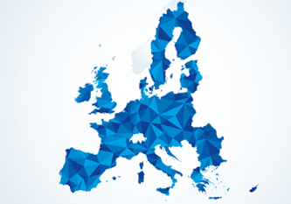
How is EMAS related to other policies?
Key environmental goals of the EU
A cut of at least 55% of GHG emissions by 2030 (compared to 1990)
17 international goals
At least 32% share for renewable energy
At least 32.5% improvement in energy efficiency
Recycling 65% of municipal waste
EMAS-registered organisations can do their part in achieving these goals.

Slide 9
In the spotlight: Six environmental core indicators?
Key area | Input/impact | Output/activity
Energy efficiency | Direct energy consumption Total renewable energy consumption Total renewable energy generation | selected and reported based on specific requirements (Annex IV EMAS Regulation)
Material efficiency | annual mass-flow of key materials used (excluding energy carriers and water)
Water | Total annual water used
Waste | Total annual generation of waste Total annual generation of hazardous waste
Land use with regard to biodiversity | Total use of land Total sealed area Total nature-oriented area on site Total nature-oriented area off site
Emissions | Annual emissions of greenhouse gases (CO₂ eq.) Annual air emissions
Indicators are mandatory and included in the environmental statement, and organisations have to show their progress over time. This information helps authorities assess and benchmark performance of organisations.

Slide 10
How can Member States’ support the uptake of EMAS?
Almost 3,900 organisations in the EU commit to reduce their environmental impacts through EMAS. What if this number reached 10,000?
Uptake of EMAS can be influenced by Member States’ level of support
The responsibility of Member States to support
Good practice examples exist
Based on the latest EMAS evaluation study, the uptake and success of EMAS greatly differs among Member States. The uptake depends on policymakers and authorities’ perception of EMAS’s added value and the level of support provided to the scheme.
The EMAS Regulation explicitly requires Member States to promote the scheme through communication and integration in relevant policies and regulations. This support is necessary to maximise the benefits of EMAS for both the state and the organisations.
Various support measures create win-win situations for authorities and EMAS-registered organisations.
Best practices have been inventoried at the EU level and can provide inspiration to other Member States.

Slide 11
Examples: What can be done by public authorities?
Authority | Power of action
National authorities/ Regulators | Introduce and implement a national strategy for EMAS Promote the scheme at national level Introduce regulatory relief in the legislation, i.e. decrease the administrative and financial burden for EMAS-registered organisations through specific advantages (e.g. reduced inspections, less reporting) because of the ability of EMAS to satisfy some of the requirements of the legislation Use EMAS to achieve targets in their areas of expertise and collaborate with other authorities
Regional or local authorities | Collaborate with EMAS-registered organisations Promote the scheme at the regional level Understand the scheme and implement regulatory relief, because the advantages are known Introduce their own support measures
Inspectors | Understand EMAS and its added value during inspections, for example by collaborating with verifiers 72% of EMAS-registered organisations would agree to send their audit report to the inspection agency, if this increases trust from authorities*
*Source: RAVE Study, 2017

Slide 12




Which instruments are available?
···························
Legal Instruments
···························
Economic & Financial Instruments
···························
Informational Instruments
···························
Marketing & Promotional Instruments
Using a combination of instruments is recommended.

Slide 13
Examples of instruments
Legal instruments
Economic instruments
Integrating EMAS in government strategies or frameworks Using EMAS in public procurement Introducing regulatory relief measures | Providing funding Introducing tax reductions or exemptions Reducing administrative fees Reducing EMAS registration fees
Organising seminars, workshops, training courses, stakeholder dialogue/roundtable Having a national EMAS website Launching long-term support projects Providing guidebooks/-lines | Disseminating brochures, factsheets, leaflets, flyers, posters … Organising conferences, sectoral promotion campaigns , a national EMAS day…
Informational instruments
Promotional instruments

Slide 14
Focus on regulatory relief
The evaluation of the EMAS regulation in 2017 (Fitness Check) highlighted that the highest EMAS uptake is achieved when Member States are successful in integrating EMAS into their environmental policy framework and implementing regulatory relief.
EMAS-registered organisations expect to benefit from regulatory relief, tax breaks or facilitated access to public procurement as a reward for their performance improvement and for their transparent and validated environmental reporting.
Regulatory relief can save time for public authorities and is justified because of EMAS’ unique features.
“EMAS organisations tend to have better prepared documentation and
evidence of compliance, so the renewal procedures of authorisation
require less time and therefore less work on the part of the
administration”
– Representative of the Regional EMAS Competent Body of Catalonia –
80% of organisations agree that regulatory relief could become a strong incentive to obtain or maintain the EMAS registration if policy makers increased their numbers *
*Source: RAVE Study, 2017

Slide 15
Examples of regulatory relief
A compendium of existing support measures in the Member States presents instruments used by Member States to promote EMAS, including regulatory relief:
Member State | Measure | Description
Spain, Catalonia | Reduction of inspections | The Directive 2010/75 EU related to Industrial Emissions (IED) identifies EMAS as one criterion for evaluating companies’ environmental impact. Catalonia divides organisations into 3 groups that determines the frequency of inspections. EMAS organisations are seen as low risk and do not have to submit to periodic controls, but the EMAS verifier must perform a specific check and submit it to authorities, to substitute inspection.
Austria | Green Public Procurement | The Federal Procurement Agency takes EMAS into account when assessing bids for cleaning and waste management services. Organisations receive extra points.
Germany | Reduction of inspections | Transposing the EU Energy Efficiency Directive, Germany introduced a new obligation for large companies to conduct an energy audit every four years. EMAS-registered or ISO 5001-certified organisations are exempted.
Greece | Reduction of fees | Companies that manage hazardous waste and are EMAS-registered receive a 50 % reduction on the required insurance fee for environmental remediation.

Slide 16
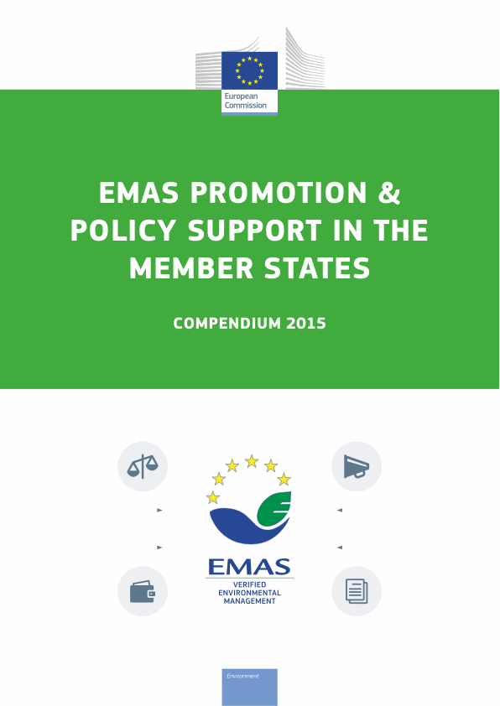
Reducing inspections related to industrial emissions
Environmental impact determines frequency of inspections → EMAS may lead to less frequent inspections. This is the case in Germany, Italy, Malta, Poland and Spain. Several Member States have further lowered IED-related costs for EMAS-registered organisations.
In Catalonia, EMAS-registered organisations have the least frequent inspections, even compared to organisations with other Environmental Management Systems such as ISO 14001.
Authorities save resources due to ready data and guaranteed legal compliance.
“We save time and resources because we have to carry out fewer environmental
inspections. And we were able to get this accepted in the regional government
because EMAS was considered in the IPPC Directive (now IED).”
– Representative of the Regional EMAS Competent Body of Catalonia –
For more information, see EMAS compendium, p. 16

Slide 17
Favouring EMAS in Green Public Procurement
Article 62 of the EU Public Procurement Directive mentions EMAS as one of three options that contracting authorities can choose from when they require the production of certificates attesting that the economic operator complies with certain environmental management systems or standards.
The Directive also includes reference to environmental aspects when determining the award criteria. Extra points for EMAS-registered organisations can also be included at this point of the process.
In Austria, EMAS organisations receive more points than ISO 14001, because of the independent verification of legal compliance signed off by public authorities. 25 out of 28 Austrian companies in the cleaning sector joined EMAS.
Austrian authorities serve as role model for industry and also decrease their own carbon footprint.
For more information, see EMAS compendium, p. 19

Slide 18
Introducing exemptions on energy audits
In Germany, EMAS-registered organisations automatically meet the requirements of the compulsory energy audit because of the mandatory energy core indicators contained in the environmental statement They only need to prove their EMAS registration status to fulfil the requirement.
For organisations that already have ISO 14001 but not ISO 50001, EMAS can present an easily achievable means of fulfilling the obligations.
“These [...] instruments help allocate scarce resources for both organisations and
regulators in a more efficient manner, leaving environmental protection agencies
more time and resources to increase inspection frequencies in higher-risk-facilities.”
– Representative of the German Ministry of Environment –
For more information see EMAS compendium, p. 17

Slide 19
Decreasing the environmental remediation insurance fee
In Greece, EMAS-registered organisations receive a 50 % reduction on the required insurance fee for environmental remediation. This discount recognizes the greater transparency and accountability of EMAS registered organisations.
Laws with EMAS privileges were passed as part of a general effort to streamline and simplify permitting processes and regulations.
“This measure [...] has played a significant role in ensuring that environmental
protection remains high in the waste management sector, despite the economic crisis,
because it offers organisations a financial incentive. At the same time the specific
measure brings no extra cost to the government and regulators, in terms of money or time.”
– EMAS Competent Body of Greece –
For more information. see EMAS compendium, p. 23

Slide 20
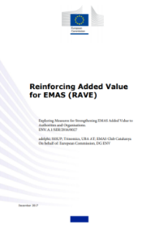
Other examples of regulatory relief measures
The RAVE study specifically looked at the potential of regulatory relief to boost EMAS. 58 best practices from Member States have been inventoried and can provide inspiration to other Member States to implement measures in their country:
Member State | Measure | Description
Austria | Fast-track or simplified permit | EMAS organisations do not need permits for facility changes if they submit a statement from the verifier guaranteeing that the changes are included in the organisation’s environmental planning. They can also get sites’ permits consolidated and approved in a single notice.
France | Reduced reporting | In the framework of CSR reporting, environmental information reported does not have to be checked by a third party auditor if already checked by an EMAS.
Germany | Tax breaks | EMAS (or an energy management system according to ISO 50001) is a precondition for energy-intensive companies in the manufacturing sector to receive a refund of their paid electricity tax (of up to 90%)
For more information see RAVE study, p. 93

Slide 21

Summary
EMAS is an instrument voluntary implemented by organisations to reduce their environmental impacts. It contributes to achieve environmental policies´ targets.
Approximately
35 % of Member States implemented regulatory relief measures. The Fitness Check shows that their potential to boost EMAS is strong and encourages Member States to use them.
Measures such as reduced inspections, tax abatements, simplified permit procedures can save both organisations and authorities time and resources.
Many examples from Member States exist. Authorities can replicate the most relevant for their country, and can combine them with informational and promotional instruments.

Slide 22
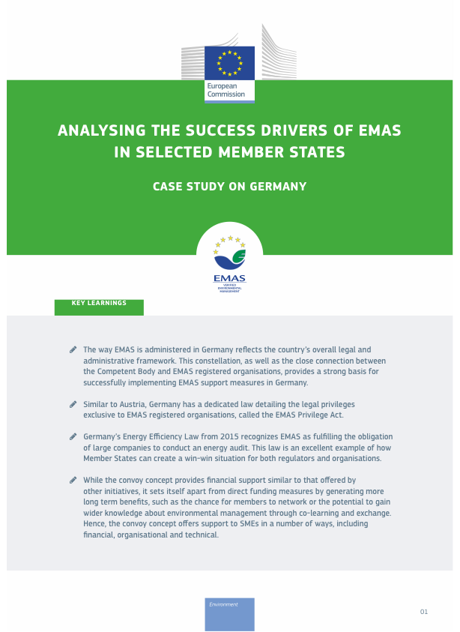

More information
Further information can be found in the following sources:
Compendium on EMAS Promotion & Policy Support in the Member States
Regulatory and Financial Support for EMAS registered organisations – Case studies from Austria, Germany, Italy
Reinforcing Added Value for EMAS (RAVE) study – Looking at the potential of regulatory relief and use of EMAS reporting

Slide 23

Additional projects and studies on regulatory relief
Further information can be found in research projects carried out:
The BRAVER project’s objective was to support the full integration of EMAS into EU environmental legislation, by reducing and simplifying the administrative costs and burdens of EMAS-registered companies
The ENHANCE project overall objective is to improve the implementation of regional policy instruments oriented to increasing the efficiency of resources by the exchange of experiences and practices on supporting EMAS registration.

Slide 24
EMAS Helpdesk
For any question, please contact:
The EMAS Helpdesk
Email: emashelpdesk@adelphi.de
Tel: +49 (30) 89 000 68 - 522
Fax: +49 (30) 89 000 68 – 10
Your national competent body
http://ec.europa.eu/environment/emas/emas_contacts/competent_bodies_en.htm
The Helpdesk is operated by adelphi in cooperation with the Austrian Umweltbundesamt, Club EMAS Catalonia, Arctik and 21 Solutions on behalf of the European Commission, Environment DG

Slide 25








Keep in touch
ec.europa.eu/
europeancommission
europa.eu/
@EuropeanCommission
@EU_Commission
EUTube
@EuropeanCommission
EU Spotify
European Commission
Notes:
Delete/update as appropriate

Slide 26

Thank you
© European Union 2020
Unless otherwise noted the reuse of this presentation is authorised under the CC BY 4.0 license. For any use or reproduction of elements that are not owned by the EU, permission may need to be sought directly from the respective right holders.
Slide xx: element concerned, source: e.g. Fotolia.com; Slide xx: element concerned, source: e.g. iStock.com
Notes:
Update/add/delete parts of the copy right notice where appropriate.
More information: https://myintracomm.ec.europa.eu/corp/intellectual-property/Documents/2019_Reuse-guidelines%28CC-BY%29.pdf

